Slide 1
Pedigrees

Slide 2
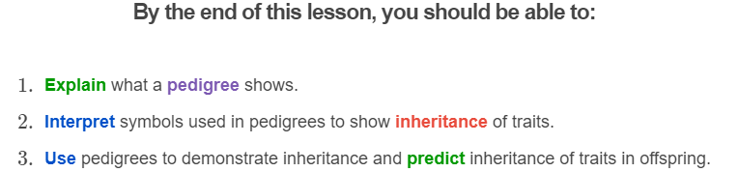
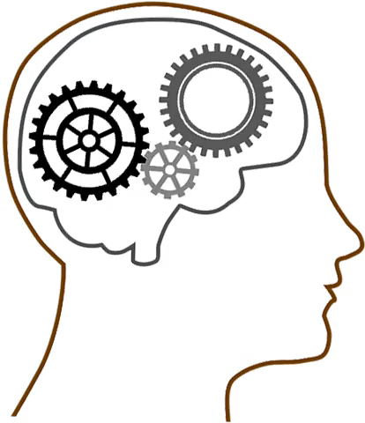

Slide 3

Pedigrees are diagrams used to show how individuals are related to one another.
They allow you to track how alleles are passed from parents to offspring across many generations.

Slide 4
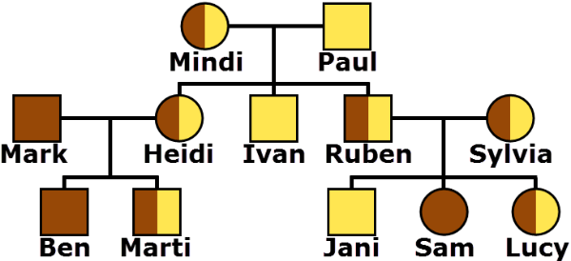
Pedigrees are similar to family trees.
In a pedigree, each circle represents a woman and each square represents a man. The colours represent the genotype of the individuals. Remember, an individual's genotype determined by the alleles they possess.
Below is the pedigree for the Koskinen family:

Slide 5
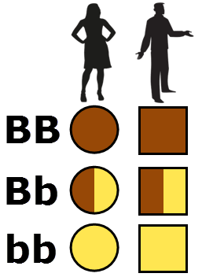
In this pedigree, we are looking at a gene that controls hair colour.
The recessive allele (b) codes for blond hair and the dominant allele (B) codes for brown.
Individuals with the genotype bb are blond and get a yellow symbol. Individuals with BB are brown haired and get a brown symbol. Individuals with Bb have brown hair but still carry an allele coding for blond hair, so their symbol is half and half.

Slide 6
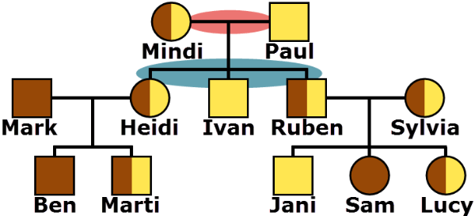
When individuals are connected by a horizontal line, shown highlighted in red below, that means they had children together.
More lines are drawn downward (highlighted in blue) to their children.
In this pedigree, we can see that Mindi and Paul are the parents of Ruben, Heidi and Ivan.

Slide 7
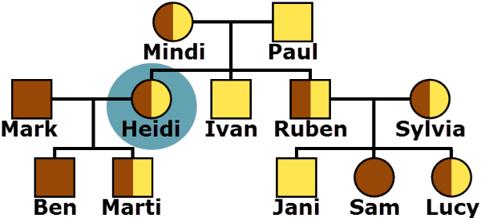
Let's practice reading pedigrees.
Heidi is highlighted in blue below. Identify which person had children with Heidi. Then, identify the names of their children.

Slide 8
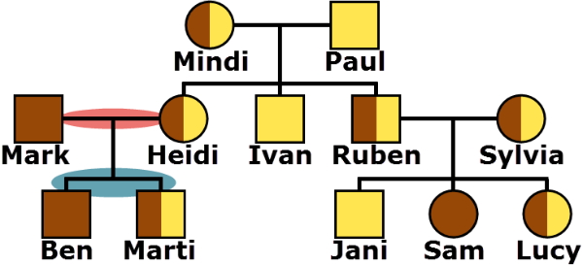
Answer:
Heidi had children with Mark. We know this because they are connected by a horizontal line, highlighted in red.
More lines are drawn downward to their children (highlighted in blue), who they named Ben and Marti.

Slide 9
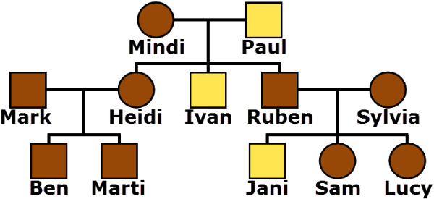
Sometimes pedigrees show the phenotypes of the individuals rather than their genotypes.
Remember, a person's alleles make up their genotype. Their traits make up their phenotype.
Below is the Koskinen pedigree redrawn to show the individuals' phenotypes. The brown symbols represent brown hair and the yellow symbols represent blond hair.

Slide 10
Pedigrees are useful for determining which alleles an individual has passed on to their offspring.
We can do this because we include the genotype of each family member in our pedigree.
Remember, we use different colours to show different genotypes.

Slide 11
For example, we can determine which allele comes from each of Marti's parents.
Heidi has the genotype Bb and her partner Mark has the genotype BB. Their son Marti has the genotype Bb.
Mark can only pass on an allele for brown hair, so Marti's allele for brown hair must have come from him. Marti's allele for blond hair must therefore have come from his mother, Heidi.

Slide 12
We can do the same for Ben.
Ben has the genotype BB. This means he must have inherited an allele for brown hair from both his mother and his father.

Slide 13
Now have a go at this practice question yourself.
Heidi has the genotype Bb. Determine which allele came from her father and which came from her mother.

Slide 14
Answer:
Paul is Heidi's father. He has the genotype bb so can only pass on an allele for blond hair. Heidi must have received her allele for blond hair from him.
That still leaves Heidi's allele for brown hair. This must have come from her mother, Mindi.

Slide 15
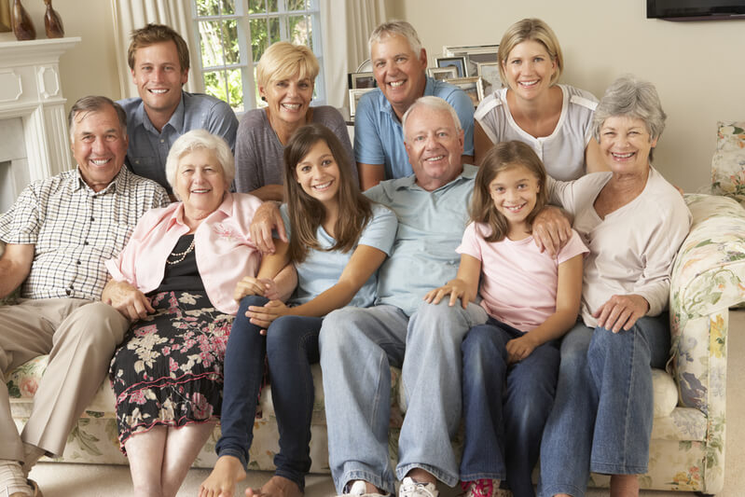
Sometimes we do not know what an individual's genotype is.
Pedigrees are often used to try and figure out what these missing genotypes could be. We will learn how to do this using the Cairns family as an example.

Slide 16
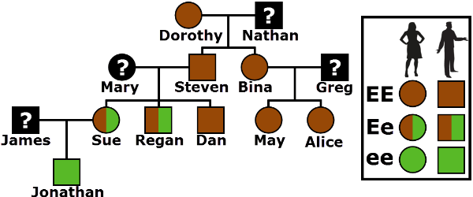
Here is the pedigree for the Cairns family.
In this pedigree, we are looking at a gene that controls eye colour. The dominant allele (E) codes for brown eyes and the recessive allele (e) codes for green eyes.

Slide 17
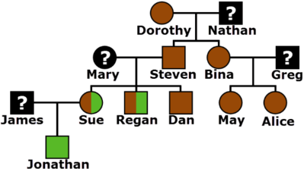
Did you notice that some genotypes are missing?
The Cairns family are genetics enthusiasts, so all of them have gotten their DNA tested to see what genotype they have. The spouses that married into the family are not so interested.
To help the Cairns complete their pedigree, we will need to determine the genotypes of some of these grumpy spouses.

Slide 18

We can determine an individual's genotype by looking at their children.
Let's start with Nathan.
Both of Nathan's children have brown symbols, indicating they have the genotype EE. This means they must have inherited the allele for brown eyes from both parents.
For Nathan to pass on an allele for brown eyes, he must have either the genotype EE or Ee, since both of these contain the allele for brown eyes.

Slide 19

Unfortunately, we cannot determine exactly what genotype Nathan has.
It could be either EE or Ee!
As you can see, pedigrees do not always enable you to determine exactly what genotype an individual has. Sometimes you are left with a couple of possibilities.

Slide 20
There are some spouses in this pedigree whose exact genotype we can determine!
Take a look at James and see if you can figure out his genotype.
His son Jonathan has a green square, indicating he has the genotype ee (green and green). Knowing this, determine James' possible genotypes. It might help you to know that James has brown eyes.

Slide 21
Answer:
Jonathan has the genotype ee, meaning he must have inherited the allele for green eyes from both parents. Therefore, James must have at least one allele for green eyes, leaving him with the possible genotypes Ee or ee.
Since James has brown eyes, he cannot have the genotype ee. Therefore, he must have the genotype Ee.
Remember, the allele for brown eyes is dominant over green eyes, so the genotype ee results in green eyes and the genotype Ee results in brown.

Slide 22

Now that you can read pedigrees you can learn about making them!
To make a pedigree, all you need to know is how the family members are related and what their genotypes are.
The following slides will take you through the steps of how to draw a pedigree using Ryan and Brie's family. They are tracking the gene for eye colour with a dominant allele for brown eyes (E) and a recessive allele for green eyes (e).

Slide 23

To make a pedigree, start by drawing a square for Ryan and a circle for Brie.
Remember, squares represent males and circles represent females. Ryan and Brie had children together, so we connect them by a horizontal line.
Ryan has one allele for brown eyes and one for green eyes (Ee), so we make half of his square green and half brown.
Brie has only the allele for green eyes (ee) so her circle is green.

Slide 24
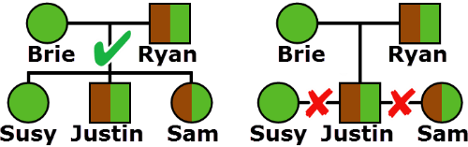
Remember, you have to be very particular about how the children are connected to their parents.
Children are connected to their parents by drawing a vertical line down from the line connecting Brie to Ryan. We then draw a horizontal line above the children and draw vertical lines down from it to each of them.
Do not connect the children directly to each other. This would suggest they had children together!

Slide 25
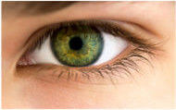
Sam is the only child who married.
She married a man named Damien and had one son called Brandon. Damien and Bradon both have the genotype EE.
Determine how Damien and Brandon should be added to the family pedigree.

Slide 26
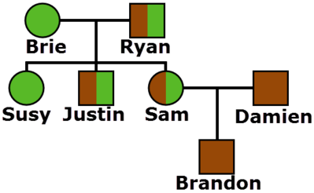
Answer:
First we place a square, representing Damien, next to Sam. The square is brown because Damien has the genotype EE. We then connect Damien and Sam by a horizontal line to show that they had a child together.
Then we place Brandon below them. He also gets a brown square since he is male and has the genotype EE. To connect him to his parents we draw a line from the centre of the line that connects Damien and Sam.

Slide 27
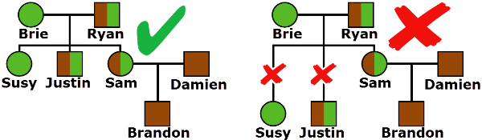
Make sure each generation is on the same level!
The grandparents are on one the top level. The parents, aunts and uncles are on the second. Finally, the children and cousins are on the bottom.

